Slide 1


Analysis
Of
Popularity
--- Social Buzz's
Presented by: Suifeng Yuan 18/4/2024

Slide 2


Today's agenda
Project recap
Problem
The Analytics team
Process
Insights
Summary

Slide 3

The popularity analysis for Social Buzz identifies the top user preferences, particularly the top 5 categories with the highest aggregate popularity, informing content strategies for optimal user engagement.
Project Recap

Slide 4

Problem
Managing rapid growth, unstructured data, and content optimization.
Ensuring scalability, engagement, and strategic preparation.

Slide 5



The Analytics team
Senior Principal
Marcus Rompton
Data Analyst
Suifeng
Data Scientist
Michelle Grove

Slide 6
Process
1
Identify relevant datasets: “Reaction”, ”Content”, and ”Reaction Types”.
2
Data Cleaning: remove rows with null values; changing the data types; and remove irrelevant columns.
3
Data Modelling: ”Content” link “Reaction” via Content ID;
“Reaction” link ”Reaction Types” via ReactionType (VLookUp).
4
Data Sum and Order: Sum up scores for each category and order them, find the top 5 performing categories.
5
Data Visualizing: Visual the findings.

Slide 7
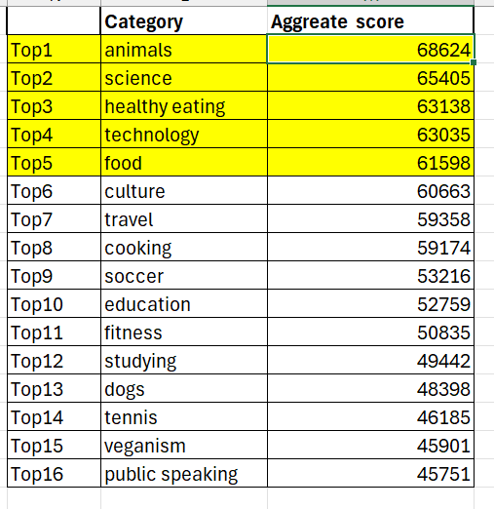

Insights

Slide 8
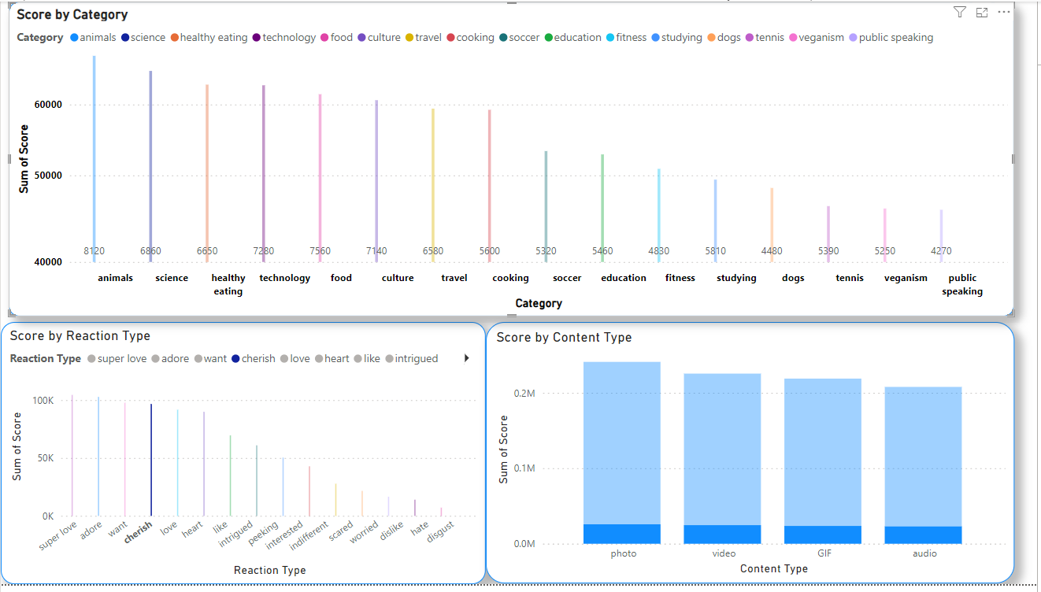
Visualizing all findings

Slide 9

The analysis of Social Buzz's content categories highlighted the top 5 most popular: Animals, Science, Healthy Eating, Technology, and Food.
Scores by reaction type and content types provide additional insights, guiding strategic content creation for enhanced user engagement and platform growth
Summary

Slide 10
Thank you!
ANY QUESTIONS?

